Slide 1

Team 3 Avi, Kyle, Mi Yon, Chad “we’re number 1”

Slide 2
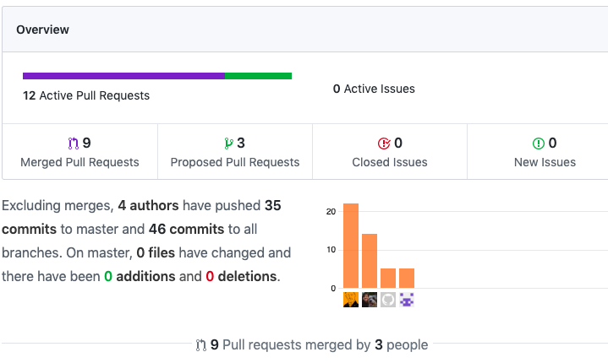
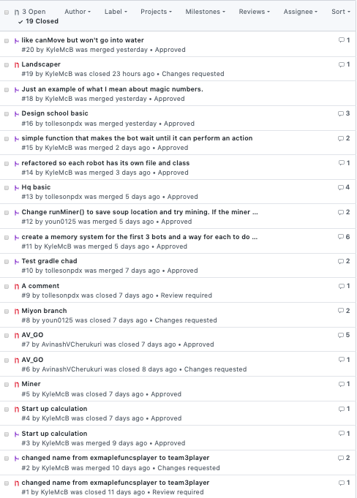
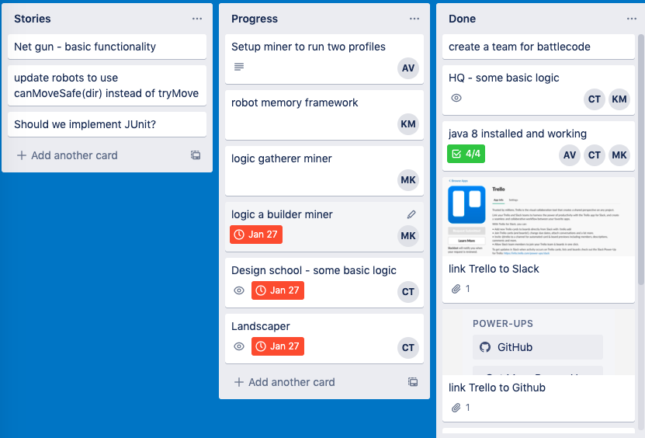
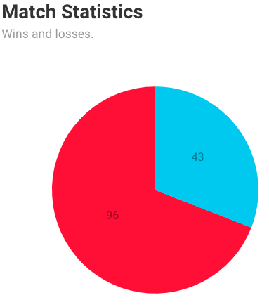

Slide 3
12 Pull Requests 46 Commits 20 Trello Stories approximately 30% win rate all team members using: GitHub, Trello, Slack, and IntelliJ

Slide 4
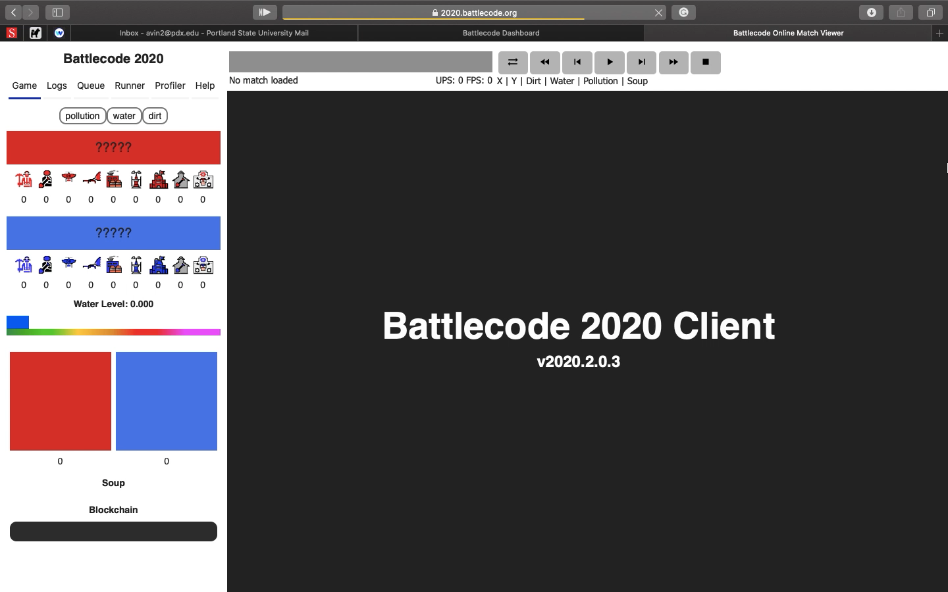

Slide 5
Team 3 Avi, Kyle, Mi Yon, Chad “we’re number 1”

